Slide 1
Web APIs
Introduction to the DOM
Lesson 4.1
Notes:
10-1010
Today will be an introduction to the DOM.

Slide 2
What are the three building blocks of the web?
Notes:
10-1010

Slide 3



Building Blocks of the Web
HTML | CSS | JavaScript
Used to write content. | Used to format content. | Used to create dynamic web applications that take in user inputs, change what’s displayed to users, animate elements, and much more.
Notes:
10-1010

Slide 4
How (or where) do we connect all three?
Notes:
10-1010

Slide 5
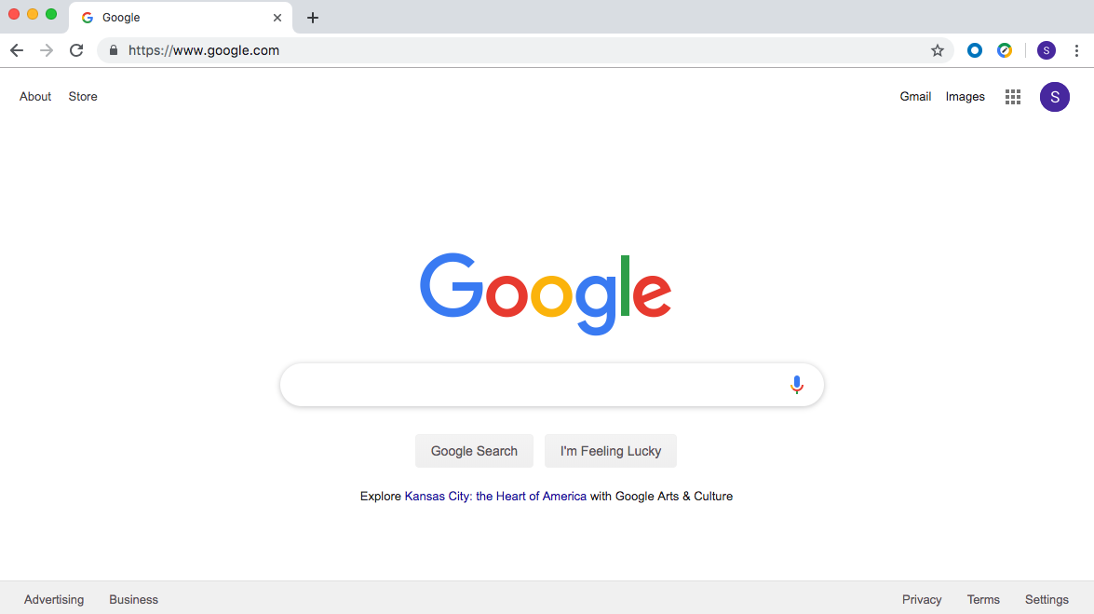
They Are Connected in the Web Browser
The browser brings together HTML, CSS, and JavaScript to create interactive webpages and applications.
Notes:
10-1010

Slide 6
What is a web browser?
Notes:
10-1010

Slide 7

A web browser, or browser, is a program used to access information on the World Wide Web. Every webpage, image and video on the web can be accessed via a specific Unified Resource Link (URL). This lets browsers retrieve these resources from a web server and display them on a user's device.
Notes:
10-1010

Slide 8

What is an application programming interface (API)?
Notes:
10-1010

Slide 9
In web development, an API is a set of code features (methods, properties, events, and URLs) that developers can use in their apps to interact with components of a user's web browser, data sets, hardware/software on a user’s computer, or third-party software and services.
Notes:
10-1010

Slide 10
What are web APIs?
Notes:
10-1010

Slide 11

Web APIs
Web APIs are built into the web browser and contain methods that allow us to manipulate a webpage using JavaScript.
We can use web APIs to create elements and add them to the browser or to add and remove styles and attributes—all via JavaScript!
Notes:
10-1010

Slide 12
Activity: This Window
See instructions in 01-Stu_This-Window in the class repo.
In this activity, you will use console.log(this) and dig around inside the returned object, answering some questions along the way.
Notes:
1010-20

Slide 13
Activity: This Window (01-Stu_This-Window)
Instructions
First open the provided index.html file in the browser and navigate to the console.
What is logged?
The window object. In this use case, this refers to the window. The window is an object representation of an open window in a browser.
Click in the window object and begin looking at the numerous properties and methods it contains.
Make your way down to document and click in it.
Spend some time looking through the properties and methods in window.document.
Notes:
1010-20

Slide 14
What is window.document?
Notes:
1020-30

Slide 15

The Document Object Model (DOM)
The DOM is an object-oriented representation of HTML (i.e., the HTML document modeled as JavaScript objects).
Each element is a node.
Nodes are organized in a tree.
Notes:
1020-30
The DOM is an Object-oriented representation of HTML. It allows us to use JavaScript to interact with the document.
The DOM represents the document so that its structure, style, and content can be changed via interaction with JavaScript. The DOM represents the document as objects and nodes. This representation allows for programmers to access the web API and modify the DOM.
When an HTML file is opened in a browser, the browser creates an object to represent the document and all of its containing elements.
With our HTML represented as objects, we can add, change or remove elements using JavaScript.
Each HTML element is referred to as a node.
The nodes are organized in a tree structure similar to the parent-child relationship of nested HTML elements.

Slide 16
What Is the Node Tree of This HTML?
<!DOCTYPE html>
<html lang="en">
<head>
<title>Document</title>
</head>
<body>
<div>Main div
<article>
<section>
</section>
</article>
</div>
<div>
<a href="myImg"></a>
<a href="secondImg"></a>
</div>
</body>
</html>
Notes:
1020-30
Ask the students to try drawing it out
Draw this on the whiteboard (or in ppt)
<!DOCTYPE html>
<html lang="en">
<head>
<title>Document</title>
</head>
<body>
<div>Main div
<article>
<section>
</section>
</article>
</div>
<div>
<a href="myImg"></a>
<a href="secondImg"></a>
</div>
</body>
</html>

Slide 17
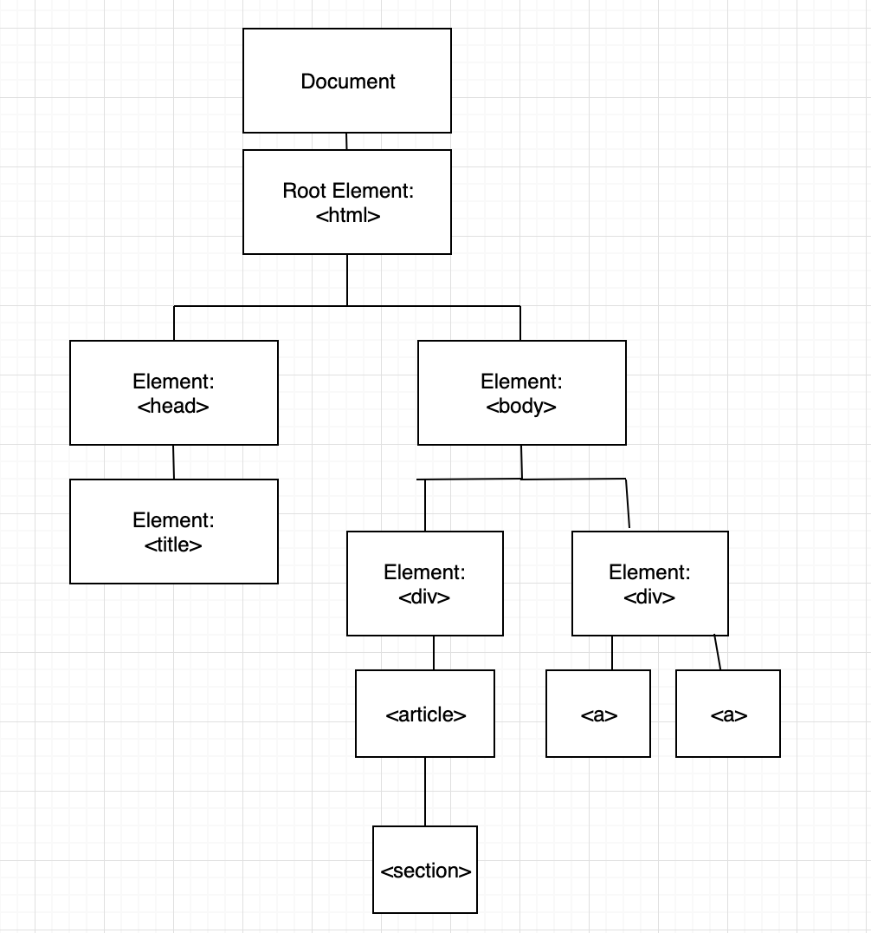
What Are the Parent, Child, and Sibling Nodes?
Notes:
1020-30

Slide 18
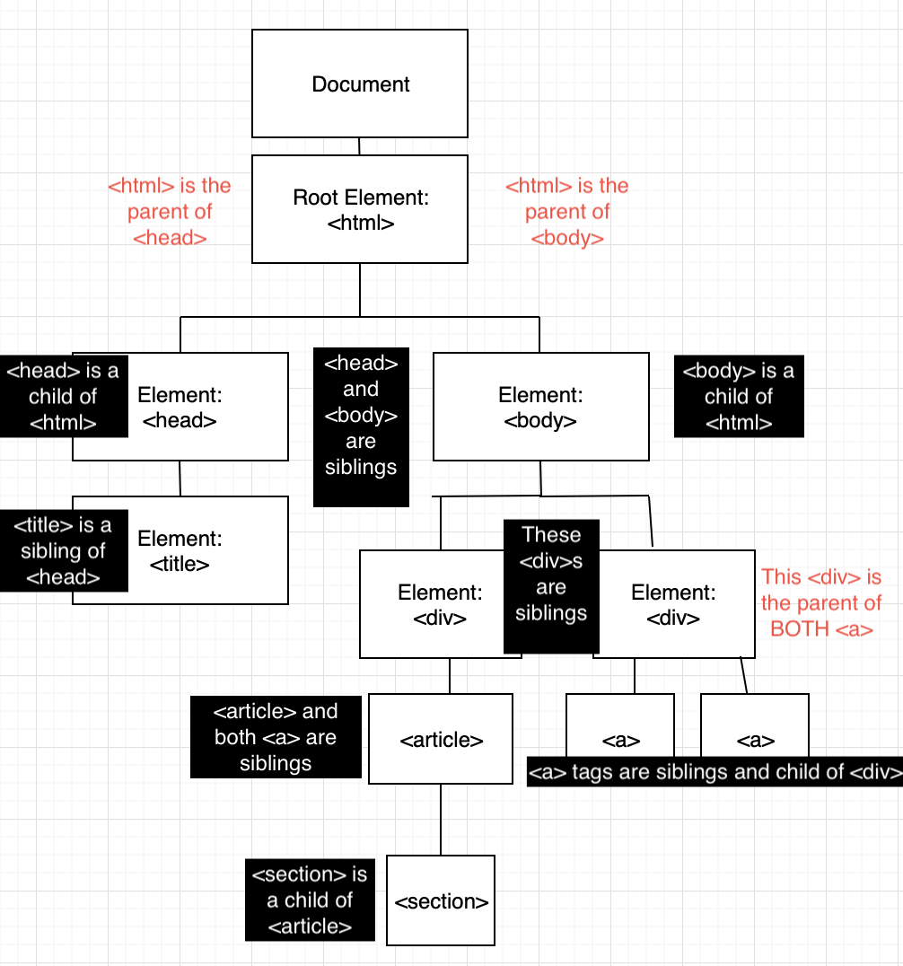
Node Relationships: Parents, Children, and Siblings
Notes:
1020-30

Slide 19
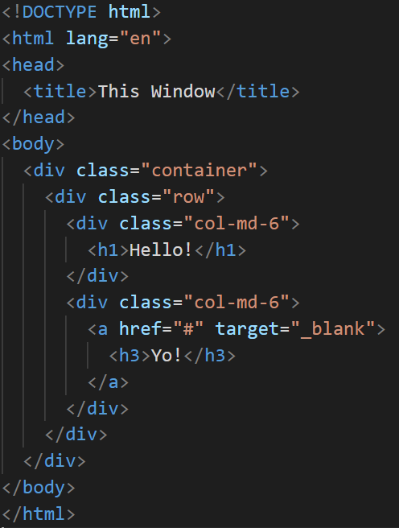
What Is the Node Tree of This HTML?
Notes:
1020-30
Ask the students to try drawing it out on paper
Draw this on the whiteboard (or in ppt)

Slide 20
What is traversing the DOM?
Notes:
1030-40

Slide 21

DOM Traversal
Navigate to the MDN DOM Docs. Open the Chrome Dev Tools and enter the following commands one by one.
console.log(document.body);
console.log(document.body.children);
console.log(document.body.children[3]);
console.log(document.body.children[3].childNodes[7]);
console.log(document.body.children[3].childNodes[7].style.fontSize = "20px");
When using the style method, properties with two words (such as font-size) become a single word and camelCased. font-size becomes fontSize.
Here is one more example of .style:
console.log(document.body.children[3].childNodes[7].parentElement.style.color = "red");
Notes:
1030-40
What is our root element? (the document)
Where is the HTML node (document.documentElement)
Where is the head? (document.head)
Where is the body? (document.body)
We can use these are starting points to traverse the DOM tree
Might need to wing which exact nodes are interesting
Console.log(document.body)
.children
[3]
.childNodes[7]
.style
.fontSize
= “20px”
Notice fontSize is camelCase

Slide 22

Our Goal Today
Navigate to the deployed Speed Reader app.
What do you not (yet!) know about how to build this application?
What do you think the steps are to build this application?
Notes:
Input is ms

Slide 23
Notes:
03 Traverse DOM (1045-55)
Review (1055-11)
"What other properties or attributes can be set using JS?“
-Anything
04 Setting Attributes (11-1110)
Open index.html
How do we feel about this style?
Uncomment the script
We can use querySelector and querySelectorAll rather than traversing the DOM tree
We can use setAttribute to modify the HTML attributes of an element
05 Setting Attributes (1110-20) (10 min)
It’s on GitLab
Review (1120-25)
setAttribute takes a property and a value
Break 1125-1205 (40 min)
06 Create Append (1205-15)
Demo first
createElement
appendChild
(student) 07 – Look Ma no HTML (1215-45) (30 min)
Review (1245-50)
08 – Timers and Intervals (1250-100)
Where are timers used in apps? (countdowns, calendars, games)
Demo index.html
Colors after a time
How did we do this?
setInterval
timerInterval is stored in a variable
Decrement seconds
Mention setTimeout
They live on window (not document)
Ask: Why do we need to clearInterval?
If we don’t it will indefinitely
setTimeout has clearTimeout
(students) 09-Speed Reader (100-120)
120-30 (review)

